Slide 1
Density and Modularity

Slide 2
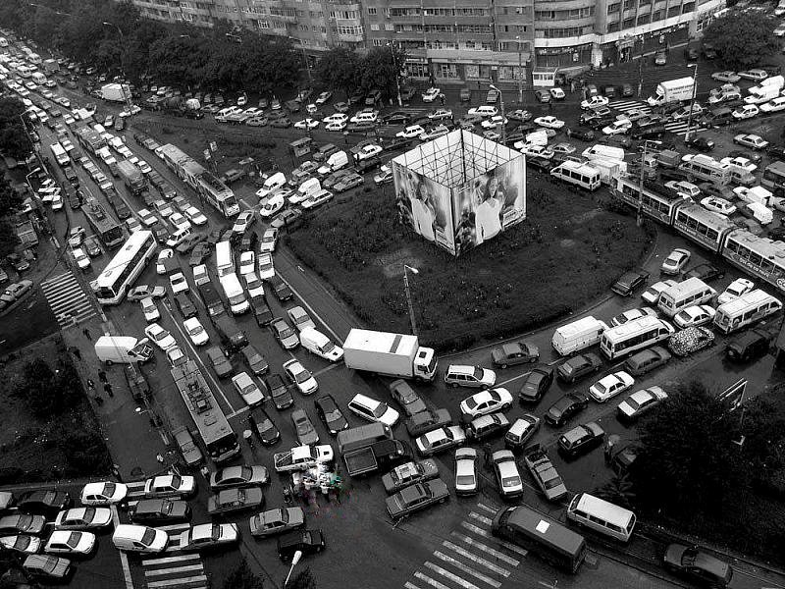
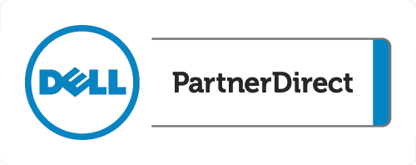
Today’s data center
Notes:
This is meant to depict the challenges of today’s data center from a logical view. The cars, trucks and trains represent new forces on the infrastructure. Infrastructures designed and built in previous years are facing new unforeseen forces and challenges. Whether it be new applications and processes, end-user requirements or the desire of the business to rapidly adapt to changing market conditions, the system sometimes breaks down. Just one unforeseen challenge or issue can have far reaching consequences which can cripple today’s IT. While It seems logical to just adapt to stay ahead of these issues, the unknown is the unknown.

Slide 3
Industry trends
Shrinking, modular data centers
2013–2015
Infrastructure convergence
Shrinking capital budgets meet increasing performance-per-kilowatt and compute-per-U
Capital deferral via vertical scale (density)
Performance gains via modularity
Logical growth without physical growth (retained footprint)
Utilization levels and compute-to-energy ratios paramount
IT indexed on business productivity and service governance
Traditional deployments and life cycles no longer tolerated
Convergence realized via software abstraction
Battle for the data center will be fought on the management plane
IT consumption
IT complexity
Data centers consume 100 times more energy than the offices they support
Energy costs are rising well ahead of inflation
Energy costs are on par with equipment capital
New KPIs: compute-to-consumption ratio and efficiency
By 2017: enterprise energy management will be its own discipline
Every 25 percent functionality increase yields a 100 percent increase in complexity
Software features x hardware features = combinational complexity
Exchange on VMware = 115 performance and capacity settings = millions of combinations
IT not deriving value from feature increase
Material additive to operational expenditures (OPEX)
Notes:
In the past 5+ years, demands on computing capability are increasing at a breakneck pace, however resources such as space, power and cooling are not always available to support. Let’s look at points from each quadrant of the slide and dig a little deeper:
Shrinking, modular data centers
How can I do more with less? This is a statement that is as old as time itself on many cases and applies to IT and industry as well. Budgets for IT are not growing at the rates at which the demands on IT are coming in. The desire to run new applications and do it quickly requires IT to get the most out of what they have within the bounds of budget, hardware and resources. Density solutions are allowing IT to deliver more compute in a smaller package at the most efficient operational model possible.
IT consumption
The first statement about data consuming 100 times more energy than the offices they support says it all. How do we reign this in and implement more power-efficient solutions that still deliver to the needs of business? Rack servers, while a dominant piece of the market, can deliver on the compute density needed.
Infrastructure convergence
Management of the data center is upwards of 60% of the cost of IT. On-going maintenance, patching of hardware, updates to software and having siloes of IT staff to support their part with a number of different tools are key drivers of this high cost. Convergence solutions based on density (blades) are solving a number of the management challenges by allowing for “one-to-many” management and maintenance.
IT complexity
Inline with the earlier management discussion, the statement that a 25 percent functionality increase yields a 100 percent increase in complexity is proof of the challenge and drives the need for less tools to manage the data center and remove redundant tasks.

Slide 4
Server market trends
Servers
Server form factor mix to 2016
IT optimizing for efficiency in power, cooling, management and density
Virtualization continues to reformulate IT as a single logical system
2012–2016: Blades CAGR 9 percent
Rack servers: 2 percent
Rack servers flat
Blades and density optimized growing
Unit Mix
Mkt Growth
 | Mkt | Dell Mix | Y/Y Unit | Y/Y Rev
4S Blade | 1% | 0.7% | 20.4% | 18.8%
2S Blade | 13% | 5% | 5.1% | 8..2%
Density Optimized | 8% | 11% | 29.8% | 38.0%
4SR | 4% | 3% | 16.4% | 20.5%
2SR | 44% | 47% | 0.6% | -2..5%
1SR | 7% | 13% | -6.7% | -13.9%
4ST | 0.1% | 0% | -4..3% | 110.5%
2ST | 9% | 7% | -4.9% | -7.8%
1ST | 14% | 13% | 6..7% | 2.6%
Density now
Industry trends align perfectly with blade value proposition—blade solutions best fit converged infrastructure/modular data center needs
Notes:
This slide is showing the current mix of server solutions in the market and which markets are growing. If you review the upper-right quadrant, overall demand for rack servers is flat or declining while the demand for density-optimized and blades solutions is growing. This exemplifies how customers are trying to solve for what we’ve discussed in doing more with optimized solutions.

Slide 5


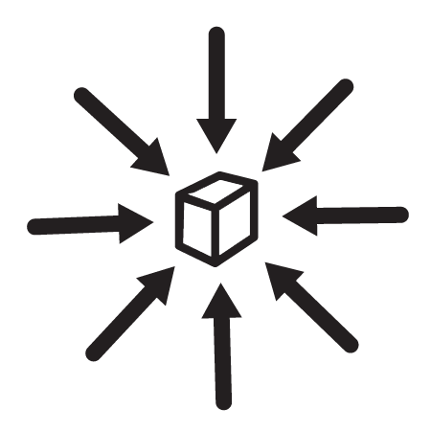


What is the value of density? It goes beyond just packing more into the same space
Generational improvements in hardware
Power and cooling efficiencies
Simpler management
Infrastructure savings
More performance
Notes:
For the foreseeable future, global business demands for IT services will continue to increase while CAPEX budgets for expanding data centers will be restricted—the classic paradigm of ”do more with less.” Dell’s resolution for our customers to address this dilemma is through comprehensive data center modularity and density. Modularity enables the customer to take advantage of new technologies in a non-disruptive environment while density enables them to increase compute, network and storage capacity. The combination of these two concepts allows them to do so without increasing the physical footprint of these resources. Dell can help our customers build a data center in a 5U standalone solution, a 42U rack or in a 25-foot container—in the cloud, on a roof or under a desk.

Slide 6
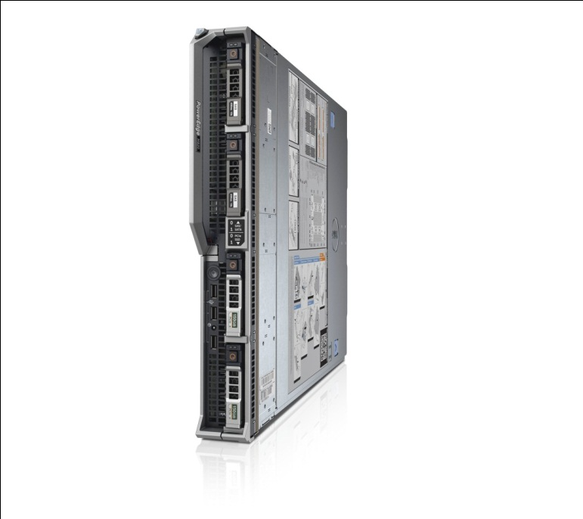
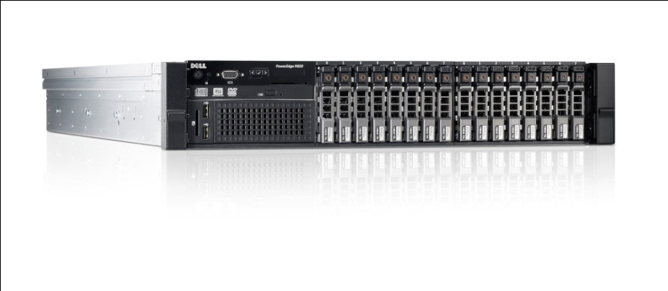
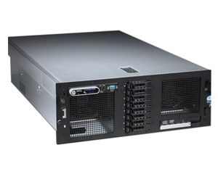
Generational improvements
5 times the performance
half the space
1/16th the space
Notes:
Gartner says that, depending on the workload, 12 to 18 months is all you need to calculate ROI for capitalization on generational improvements.
In less than half the space
With less than half the managed nodes
With a fraction of the power and cooling
This is compelling, revelatory information for the CIO or data center manager. Even factoring in migration costs, updates to OS and application upgrades like relational databases, etc. it is still a worthwhile investment because those are defrayed by/paid for by the savings.
Generational improvements in hardware enable businesses to take advantage of consolidation through virtualization and increased density in standard server deployments. It also enables standardization—managing the same types of nodes in varying configurations to power the workloads that they’re running. With processor, memory, networking and storage technologies improving at such a pace, updating hardware alone is a strong enabler of consolidation and driver of density.

Slide 7
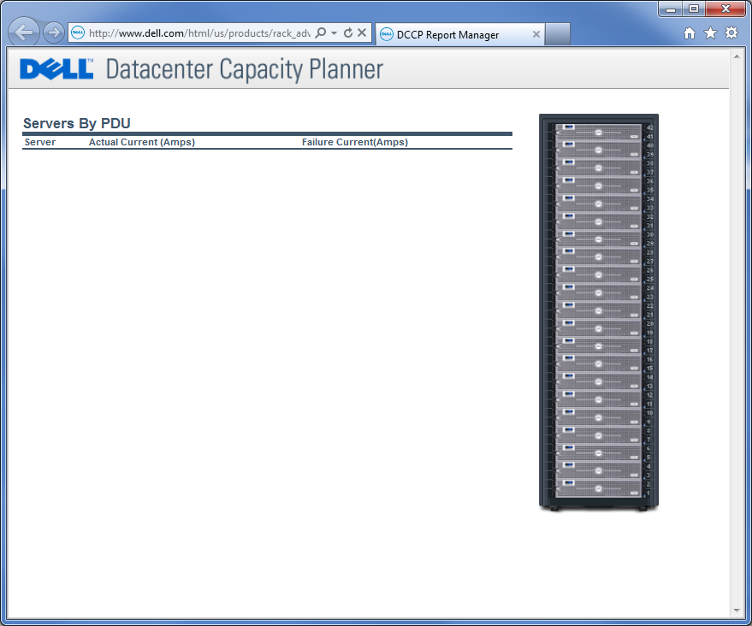
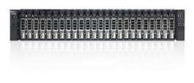
Power and cooling savings
Notes:
Let’s take it to the savings that can be realized by power and cooling achieved through density.
What we are looking at is a sample table from a Principled Technologies white paper. Yes, this is consolidation through MSSQL server consolidation. Remember that consolidation and density are enabled by new technologies and improvements at the software layer as well as the hardware layer, and the benefits are compounded.
Let’s take another look at just what this graph represents: *CLICK* Interesting, isn’t it?
Simply put, high-density virtualized and monolithic solutions consolidate the work of many older servers, significantly lowering power and cooling costs.

Slide 8
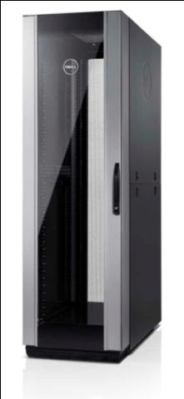
Power and cooling savings
Dell™ PowerEdge™ Energy Smart Containment Rack Enclosures
40U (based on 42U) and 46U (based on 48U) stand-alone, cold-air cabinets for raised-floor data centers
Integrated containment increases IT density and improves cooling efficiency
Benefits
Improve efficiency and reduce operating expenses with no over-provisioning or waste
Easy to deploy and install, no assembly required
Affordable and scalable containment—add one rack at a time anywhere in the data center
Creates an opportunity to do something new
Notes:
All of this density begs the question, “aren’t new servers and blades, with all of that processing power, absurd amounts of memory and all of those hard drives actually consuming more power and generating more heat on a per-rack-U basis, especially considering how many of those compute nodes one can get into a rack? Aren’t customers going to have to re-tool their data centers to accommodate that kind of density?” The answers are” sometimes”, ”it depends”, “yes”—but also “no”.
High-density data centers need to employ more focused delivery of power and cooling resources resulting in increased efficiency—but how to do that within the constraints that exist? The simplest approach is truly the best. *CLICK*
That’s how we came up with the Energy Smart Containment Rack Enclosure. *CLICK* It’s even available in a high-density configuration with six extra rack Us. It goes into existing data centers that employ raised-floor computer room air conditioning (CRAC) cooling. It increases IT density and improves cooling efficiency. *CLICK* It improves efficiency and reduces OPEX. It’s easy to deploy—just like any other rack. It’s affordable and scalable—do it project-based and deploy one at a time. Most importantly, it creates an opportunity for customers to do something new.

Slide 9
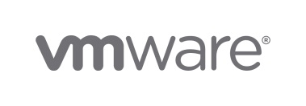


Elegantly simple manageability Dell’s integrated infrastructure management approach
Dell OpenManage™ Power Center
Aggregated data center power management
VMware® vCenter™ plug-ins Complete server and storage hardware management
Dell EqualLogic™ host integration tools
Datastore management
Auto-snapshot management
VDI deployment
Blade chassis management console
Chassis infrastructure configuration
N:1 firmware updates to blades
Chassis cloning
Dell OpenManage integration suite Complete server and storage hardware management
Dell EqualLogic host integration tools
Auto-snapshot management
Powershell extensibility
MPIO
Dell Repository Manager
Build custom lifecycle update catalogs
Store behind firewall
Notes:
Infrastructure management provided using the virtualization management console that you already use today.
Repository Manager enables customers to build a custom lifecycle update catalog
Repository Manager can work through a proxy server to build the custom repository
A custom repository of updates can then be stored behind the firewall on a network share or USB key
Lifecycle controller enables customers to update their servers via the repository
Benefits of utilizing Repository Manager with lifecycle technology for system updates:
Update systems safely behind the firewall
Does not expose systems to Internet-based threats. Only Repository Manager requires access to the Internet
Provides easy/safe methodology for building shared environment and ensuring preservation of master catalog that can be shared to systems behind the firewall as needed
Own version control
Create collections of updates in Repository Manager to manage which ones to distribute
Isolates systems from ‘real time’ changes on the global Dell site
Implement updates to your systems based on your needs
Apply updates at the system and component level
Smaller repositories instead of large 4GB files
USB for updates to a small number of local servers
Local share for a large number of servers
Maintain separate repositories for different workload environments
Build libraries based on workload stack certifications or server type
Develop test/dev and production repositories as needed

Slide 10
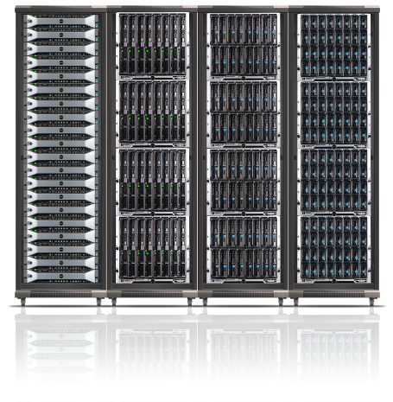
Physical space savings
High-density and virtualized solutions decrease the number of physical servers or the space they occupy, increasing available floor space. This allows companies to utilize physical space more efficiently and free up area for new investments
In leased multi-tenant environments, reduction in rented space may save a lessee money
Notes:
This is really an easy one, a no-brainer if you will.
High-density and virtualized solutions, compounded, dramatically decrease the number of physical servers or the space they occupy, thus increasing available floor space.
Here’s the important part. This allows companies to utilize physical space more efficiently and free up area for new investments. In leased multi-tenant environments, such as colocation facilities, a reduction in rented space may save a lessee money.
If, as a customer, I’m able to dramatically affect my physical footprint, what else can I save on?

Slide 11
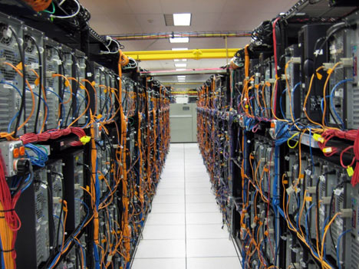
Infrastructure savings
High-density consolidated solutions can reduce or avoid build-out costs, as less square footage and cabling are required for denser solutions that require fewer physical servers, or servers optimized for density.
Notes:
I can actually avoid having to do a build out, an expansion of an existing data center into office space, or moving to a different facility. When that next shipment of servers that you’ve always gotten puts you over the limit of what you can deliver in the space you’ve got, it’s the most expensive Oracle implementation EVER. *CLICK* What is this customer going to do? Can they continue this trend? Is it sustainable?
Just imagine how successful you could be if you led with density in this data center.

Slide 12
Solutions
Solutions

Slide 13
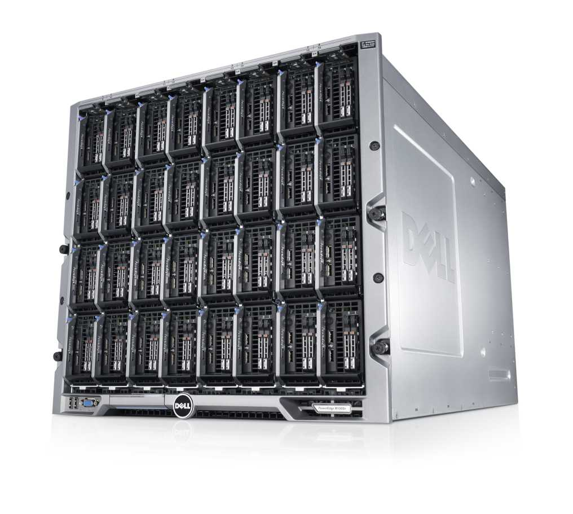
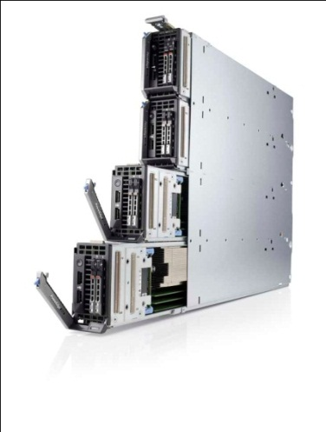
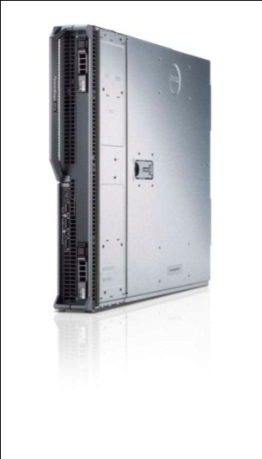
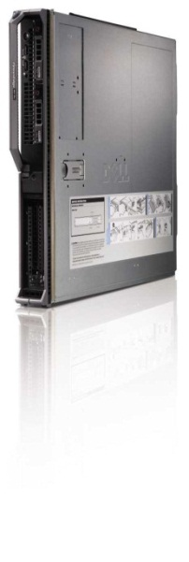
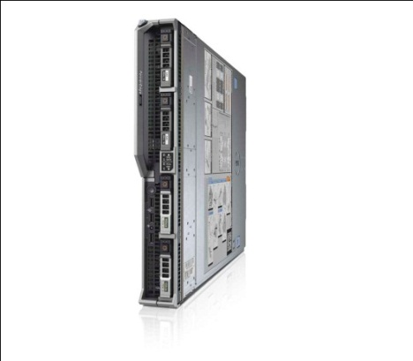
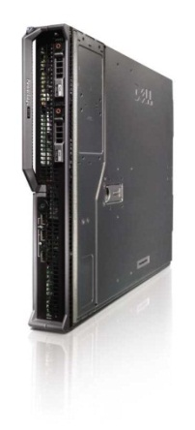
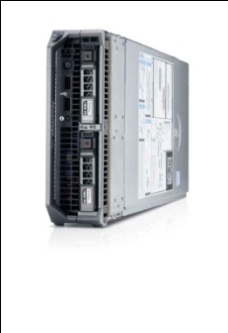
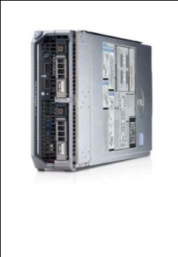
Dell PowerEdge M-Series Blade Server portfolio
M-Series blades couple powerful computing capabilities with optimized connectivity that works with virtually any network, storage or management infrastructure.
Dell blades are designed with the customer in mind, and deliver all of the legendary reliability, efficiency and manageability that Dell is known for in 180 countries around the world.
PowerEdge M1000e
M420
M520
M620
M820
M915
M910
M910
M610X
Notes:
This slide shows the core of Dell’s density portfolio with the M1000e. We have a number of different solutions from dual-socket to quad-socket servers in a wide range of form factors from quarter height to full height. In fact, the Dell M420 is the industry’s first quarter-height dual-socket blade which allows for unmatched density and processing power in an enterprise-class blade solution.
Results:
Saves time and resources: Focus on delivering innovation to your organization
Saves you real money: Invest back into innovation for your organization
Delivers Adaptable Infrastructure: Changes with your organization's growing needs

Slide 14
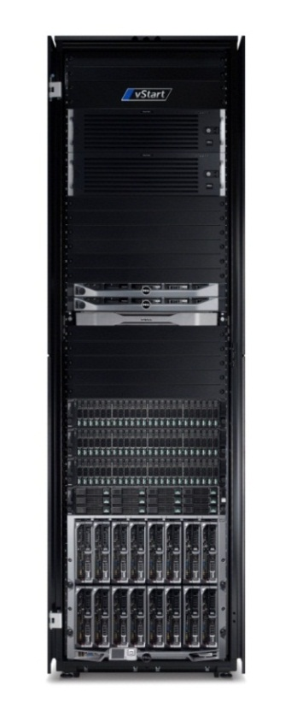
Active System 800 Pre-integrated solution for simplified, scalable blade server infrastructures
Ideal platform for private clouds and apps such as SQL and collaboration that is easily managed by IT admin with multiple roles
Accelerate time-to-value: make virtual infrastructure rapidly productive for applications and cloud initiatives
Drive efficiency and lower risk: pre-engineered infrastructure for greater reliability, standardization and reduced time and costs
Deliver future-proof scalability and flexibility: provide the foundation with robust and scalable data center infrastructure
Notes:
As we discussed back on slide three, converged infrastructure solutions are delivering efficiency today. Many of the challenges of IT are associated with how to acquire, deploy and manage technology to support the need for new applications and services. Converged solutions are accelerating time to value by taking the need to build one-off solutions for each new applications and allowing for the rapid implementation of the new solutions.
New software solutions to manage not only the configuration of the hardware stack, but also the applications are allowing for greater automation, less manual intervention and repeatable predictable results.
The Active System 800 is just one example of Dell’s converged portfolio of solutions that are right-sized to customer needs.

Slide 15
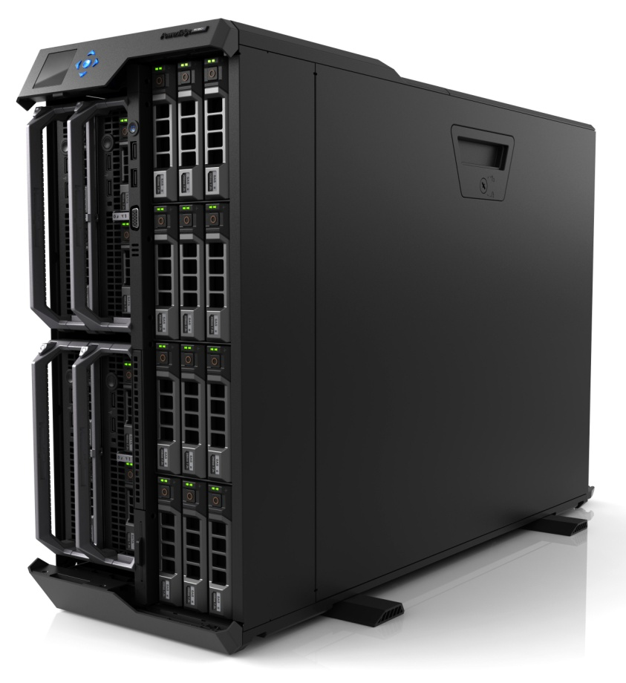
Dell PowerEdge VRTX Revolutionary fully integrated, scalable, easy-to-manage office-optimized data center
Experience greater simplicity
Save space with servers, storage and networking converged into a desk-side chassis
Familiar platforms and technologies inside the box
Integrated, pre-tested and certified for confident deployment
Realize improved efficiency
Save time and reduce potential for error with unified and simplified systems management
Ensure more uptime with high-availability features and live migration
Reduce capital and operational expenses with consolidation and virtualization
Discover greater versatility
Office power profile and desk-side acoustics
Extensive scalability within a stable platform
Support for future PowerEdge 13th generation servers protects IT investment
Dell PowerEdge VRTX with four half-height server nodes and 12 3.5-inch HDDs

Slide 16
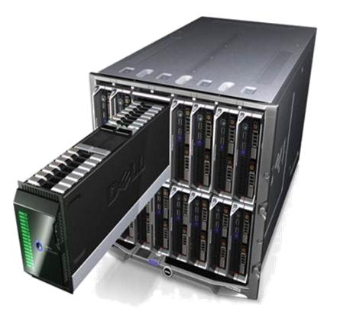
Density is about more than compactness
The innovators’ dilemma
Density creates room for something new
M1000e is the vehicle for the converged blade data center
MXL and IOA allow for 64 ports of 10GbE on fabric A
32 M420s takes full advantage of those ports
PS-M4110 allows for simple deployment of enterprise storage
CMC enables simple management of this ecosystem
Notes:
The solution depicted here is a wholly differentiated solution from Dell that is redefining the market.
http://i.dell.com/sites/doccontent/business/solutions/whitepapers/en/Documents/unique-platform-converged-data-centers.pdf
We were prescriptive in choosing the initial components in the Dell Converged Blade Data Center solution to help customers achieve greater application and service agility and efficiency. If you have other specific needs to be addressed, you also have the flexibility to customize the solution.
Begin with the M1000e—it is the foundation to build the entire CBDC on—designed from the ground up to deliver density, but there are physical constraints within the chassis that can limit its scale, but how limiting are those factors?
The MXL and IOA build on that foundation, providing double the 10GbE ports as previous generation 10GbE switches. Another way to look at it is that they have more than 10 times the bandwidth as the M6348—making room for something new, with greater efficiency.
The M420 is that something new. A platform that delivers next-generation performance within the physical constraints of the M1000e, while doing so with enterprise-class features that are unmatched—a truly unique offering!
Another “something new” made possible by the combination of these elements is the PS-M4110, the industry’s first enterprise-class blade storage with performance and capacity.
Finally, the payoff comes with the CMC.
Dell Equallogic PS-M4110 Blade Array is an enterprise-class storage array inside the chassis. This enables not only an improvement in density, but also simplifies the environment. The blade array has full EqualLogic family capabilities, so there is no compromise in performance. With two of these arrays inside of a chassis, both are managed from the same EqualLogic group, making storage administration simple.
Dell PowerEdge M420 is the world’s first quarter-height blade, giving industry-leading density without compromising on enterprise features. The blade was also chosen to maximize node count to enable customers to consolidate a large number of workloads within the chassis, including physical workloads.
Dell Force10 MXL switch is the world’s first 40GbE stacking IOM switch. MXL supports data center bridging (DCB) to provide a unified fabric for LAN and SAN, which provides simplicity and flexibility. You get extreme port density and local switching for extremely fast east-west traffic between servers and to storage, and high-performance networking up to the core with multiple 40GbE uplink capability.
Finally, we are providing guidance on the best way to manage this converged solution, leveraging Dell's integrated management approach where we allow customers to manage their physical server and storage infrastructure via the virtual management tools of their choice from either VMware or Microsoft.

Slide 17
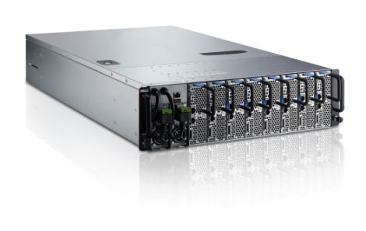
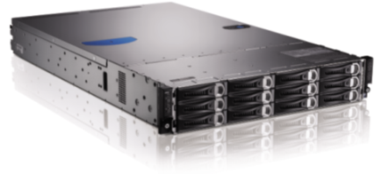
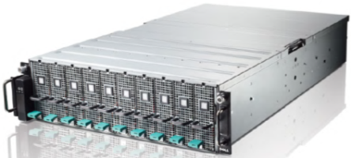

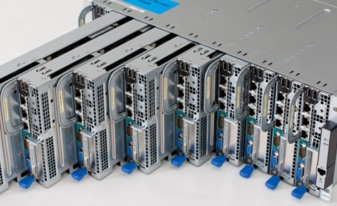
PowerEdge-C: Cloud Builders, Web 2.0, HPC
3U shared infrastructure microserver
PowerEdge c5220
2U shared infrastructure
PowerEdge C6220
3U PCIe expansion chassis
PowerEdge C410X
4U shared infrastructure
PowerEdge C8000
Purpose-built for scale-out rack deployments, large homogenous cloud/cluster application environments where density is required and the software stack provides platform availability and resiliency
Notes:
To wrap up our conversation on density, let’s discuss another important piece of our product line. Up to this point we have been talking mainly about mainstream blades solutions which offer a number of choices for customers. Now we’ll touch briefly on Dell’s density-optimized solutions. If you think back to slide three, density-optimized solutions are a fast-growing piece of the market and Dell holds more than 50 percent market share in the space showing our position as a market and thought leader. PowerEdge-C solutions are aimed at the Web 2.0 space and those customers who need unmatched density and flexibility in solutions. These solutions don’t contain all of the redundancy and management capabilities of mainstream serves and therefore rely on the software stack to provide those capabilities. These solutions were born out of Dell’s data center solutions business where servers are designed, customized and built using an on-demand manufacturing (ODM) model. There were some common configurations being requested by hyperscale/web 2.0 customers and evolved to become more readily available to a broader market as PowerEdge-C.

Slide 18

Thank you
View the detailed white paper from Principled Technologies that accompanies this audio cast.
For more information, contact your account manager or visit the partner portal.

Slide 19
声明：
所有的版权属于原有公司，文件均来自公开渠道
此文件仅供学习使用，任何人不得进行以此为商业目的的行为
如有疑问，请立即删除
学习世界五百强和咨询公司PPT课程请访问如下网站搜索：“司马懿”
百度传课：司马懿PPT学校
网易学堂：司马懿PPT学校
知乎： 司马懿PPT学校
访问地址
https://www.chuanke.com
访问地址
https://study.163.com
访问地址
https://www.zhiu.com

